Slide 1

Comparisons of the BNB and NuMI Kinematics of $ν_{e}$’s and outgoing electrons
Krishan Mistry
13th August 2018

Slide 2

Incoming $ν_{e}$

Slide 3

Outgoing Electron from $ν_{e}$ Interaction

Slide 4
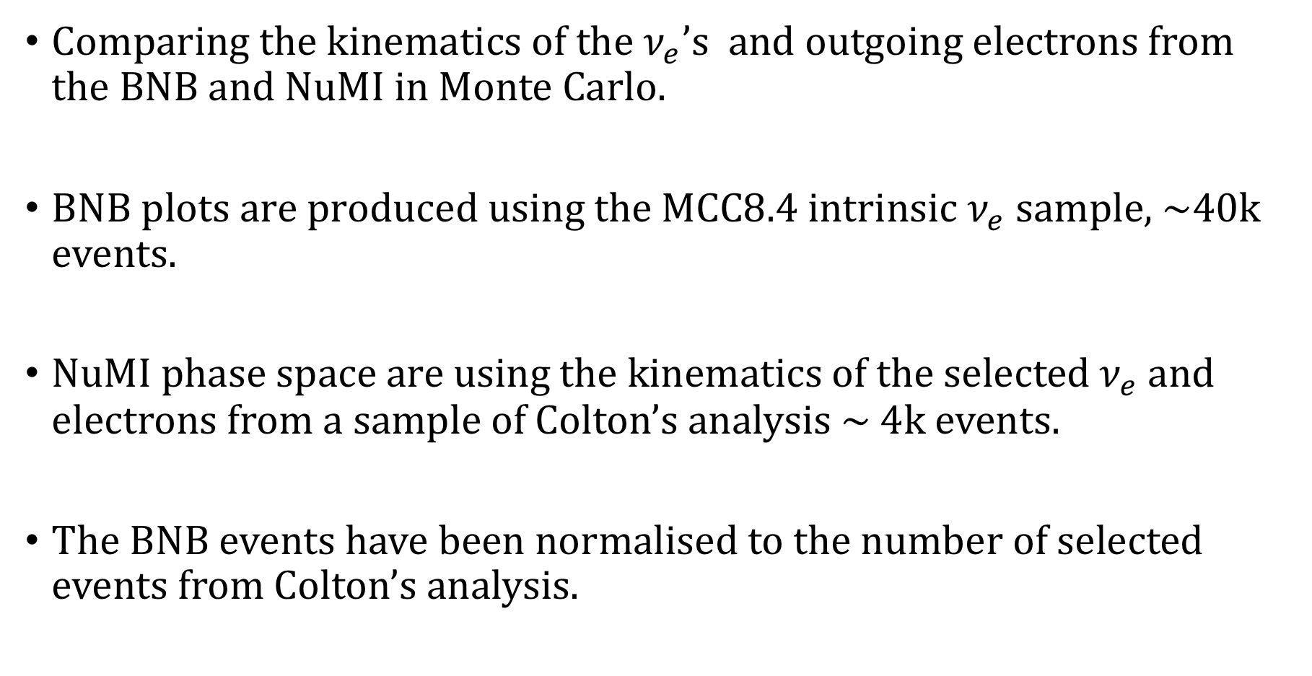
Some details about the plots
Comparing the kinematics of the $ν_{e}$’s and outgoing electrons from the BNB and NuMI in Monte Carlo.
BNB plots are produced using the MCC8.4 intrinsic $ν_{e}$ sample, ~40k events.
NuMI phase space are using the kinematics of the selected $ν_{e}$ and electrons from a sample of Colton’s analysis ~ 4k events.
The BNB events have been normalised to the number of selected events from Colton’s analysis.

